Slide 2

The Spark File Format Ecosystem
Vinoo Ganesh
Chief Technology Officer, Veraset

Slide 3

Agenda
About Veraset Session Goals On-Disk Storage
OLTP/OLAP Workflows File Format Deep Dive Case: Veraset
Case: Parquet Pruning Looking Forward Questions

Slide 4

About Veraset
We’re Hiring! vinoo@veraset.com
About Me
CTO at Veraset
(Formerly) Lead of Compute / Spark at Palantir Technologies
Data-as-a-Service (DaaS) Startup Anonymized Geospatial Data
Centered around population movement
Model training at scale
Heavily used during COVID-19 investigations / analyses
Process, Cleanse, Optimize, and Deliver >2 PB Data Yearly Data is Our Product
We don’t build analytical tools
No fancy visualizations
Optimized data storage, retrieval, and processing are our lifeblood
“Just Data”

Slide 5
Session Goals
We can’t cover everything about file formats in 30 minutes, so let’s hit the high points.
On-disk storage
Row, Column, Hybrid
Introduce OLTP / OLAP workflows
Explain feature set of formats Inspect formats
Explore configuration for formats Look forward

Slide 6
File Formats
Bolded formats will be covered in this session
Unstructured
Semi-Structured
Structured
JSON
XML
Avro
ORC
Parquet
Text
CSV *
TSV *
* Can be considered ”semi-structured”

Slide 7
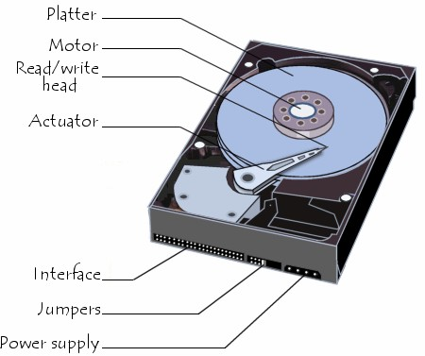
On-Disk Storage
Data is stored on hard drives in “blocks” Disk loads a “block” into memory at a time
Block is the minimum amount of data read during a read
Reading unnecessary data == expensive! Reading fragmented data == expensive!
Random seek == expensive!
Sequential read/writes strongly preferred
Insight: Lay data on disk in a manner optimized for your workflows
https://bit.ly/2TG7SJw
Common categorizations for these workflows: OLTP/OLAP

Slide 8
Example Data
Column A
Column B
Column C
Row 0
Row 1
Row 2
Row 3
A0 | B0 | C0
A1 | B1 | C1
A2 | B2 | C2
A3 | B3 | C3

Slide 9
Example Data
Column A
Column B
Column C
Row 0
A0
B0
C0
Row 1
A1
B1
C1
Row 2
A2
B2
C2
Row 3
A3
B3
C3

Slide 10
Row-wise Storage
Visually
A0 | B0 | C0
A1 | B1 | C1
A2 | B2 | C2
A3 | B3 | C3
On Disk
A0 | B0 | C0 | A1 | B1 | C1 | A2 | B2 | C2 | A3 | B3 | C3
Block 1
Block 2
Block 3

Slide 11
Columnar (Column-wise) Storage
Visually
A0 | B0 | C0
A1 | B1 | C1
A2 | B2 | C2
A3 | B3 | C3
On Disk
A0 | A1 | A2 | A3 | B0 | B1 | B2 | B3 | C0 | C1 | C2 | C3
Block 1
Block 2
Block 3

Slide 12
Hybrid Storage
Visually
A0 | B0 | C0
A1 | B1 | C1
A2 | B2 | C2
A3 | B3 | C3
Logical Row Groups
A0 A1 B0 B1 C0 C1
A2 A3 B2 B3 C2 C3
Row Group 1
Row Group 2

Slide 13
Hybrid Storage
In Parquet – aim to fit one row group in one block
Logical Row Groups
A0 A1 B0 B1 C0 C1
A2 A3 B2 B3 C2 C3
Row Group 1
Row Group 2
On Disk
A0 | A1 | B0 | B1 | C0 | C1 | A2 | A3 | B2 | B3 | C2 | C3
Block 1
Block 2
Block 3

Slide 14
Summary: Physical Layout
Row-wise formats are best for write-heavy (transactional) workflows
Columnar formats are best optimized for read-heavy (analytical) workflows
Hybrid formats combine both methodologies

Slide 15
OLTP / OLAP

Slide 16
OLTP / OLAP Workflows
Online Transaction Processing (OLTP)
Larger numbers of short queries / transactions
More processing than analysis focused
Geared towards record (row) based processing than column based
More frequent data updates / deletes (transactions)
Online Analytical Processing (OLAP)
More analysis than processing focused
Geared towards column-based data analytics processing
Less frequent transactions
More analytic complexity per query
Insight: Data access patterns should inform the selection of file formats

Slide 17
Example Data
student_id | subject | score
71 | math | 97.44
33 | history | 88.32
101 | geography | 73.11
13 | physics | 87.78
Row 0
Row 1
Row 2
Row 3

Slide 18
Unstructured File Format: CSV

Slide 19
About: CSV
* Some formatting applied
$ cat myTable.csv "student_id","subject","score" 71,"math",97.44
33,"history",88.32
101,"geography",73.11 13,"physics",87.78
scala> val table = spark.read.option("header","true")
.option("inferSchema", "true").csv("myTable.csv")
table: org.apache.spark.sql.DataFrame = [student_id: int, subject: string ... 1 more field]
scala> table.printSchema root
|-- student_id: integer (nullable = true)
|-- subject: string (nullable = true)
|-- score: double (nullable = true)
scala> table.show
+----------+---------+-----+
|student_id| subject|score|
+----------+---------+-----+
71| math|97.44| 33| history|88.32|
101|geography|73.11|
| 13| physics|87.78|
+----------+---------+-----+
Comma Separated Value (CSV)
CSV developed by IBM in 1972
Ease of typing CSV lists on punched cards
Flexible (not always good) Row-based
Human Readable
Compressible Splittable
When raw / using spittable format
Supported Natively
Fast (from a write perspective)
|
|
|

Slide 20
Semi-Structured File Format: JSON

Slide 21
About: JSON
* Some formatting applied
JSON (JavaScript Object Notation)
Specified in early 2000s
Self-Describing
Row-based Human Readable Compressible
Splittable (in some cases) Supported natively in Spark Supports Complex Data Types Fast (from a write perspective)
$ cat myTable.json
{"student_id":71,"subject":"math","score":97.44}
{"student_id":33,"subject":"history","score":88.32}
{"student_id":101,"subject":"geography","score":73.11}
{"student_id":13,"subject":"physics","score":87.78}
scala> val table = spark.read.json("myTable.json") table: org.apache.spark.sql.DataFrame = [score: double, student_id: bigint ... 1 more field]
scala> table.show
+-----+----------+---------+
|score|student_id| subject|
+ + + +
71| math| 33| history| 101|geography|
|87.78| 13| physics|
+-----+----------+---------+
|97.44|
|88.32|
|73.11|

Slide 22
Structured File Formats: Avro, ORC, Parquet

Slide 23

About: Avro
Data Format + Serialization Format Self-Describing
Schema evolution
Row-based
Optimized for write-intensive applications
Binary Format – Schema stored inside of file (as JSON) Compressible
Splittable
Supported by external library in Spark Supports rich data structures

Slide 24
Inspecting: Avro
* Some formatting applied
$ avro-tools tojson part-00000-tid-8566179657485710941-115d547d-6b9a-43cf-957a-c549d3243afb-3-1-c000.avro
{"student_id":{"int":71},"subject":{"string":"math"},"score":{"double":97.44}}
{"student_id":{"int":33},"subject":{"string":"history"},"score":{"double":88.32}}
{"student_id":{"int":101},"subject":{"string":"geography"},"score":{"double":73.11}}
{"student_id":{"int":13},"subject":{"string":"physics"},"score":{"double":87.78}}
$ avro-tools getmeta part-00000-tid-8566179657485710941-115d547d-6b9a-43cf-957a-c549d3243afb-3-1-c000.avro avro.schema {
"type" : "record",
"name" : "topLevelRecord", "fields" : [ {
"name" : "student_id",
"type" : [ "int", "null" ]
}, {
"name" : "subject",
"type" : [ "string", "null" ]
}, {
"name" : "score",
"type" : [ "double", "null" ]
} ]
}
avro.codec snappy

Slide 25
Config: Avro
* Default value is underlined
spark.sql.avro.compression.codec
What: Compression codec used in writing of AVRO files
Options: {uncompressed, deflate, snappy, bzip2, xz}
spark.sql.avro.deflate.level
What: Compression level for the deflate codec
Options: {-1,1..9}

Slide 26

About: ORC
Next iteration of Hive RCFile
Created in 2013 as part of Stinger initiative to speed up Hive
Self-Describing
Hybrid-Based (rows grouped by row groups, then column partitioned)
Optimized for read-intensive applications
Binary Format – Schema stored inside of file (in metadata) Compressible
Splittable
Supported by natively in Spark Supports rich data structures
Hive data Type Support (including compound types): struct, list, map, union

Slide 27
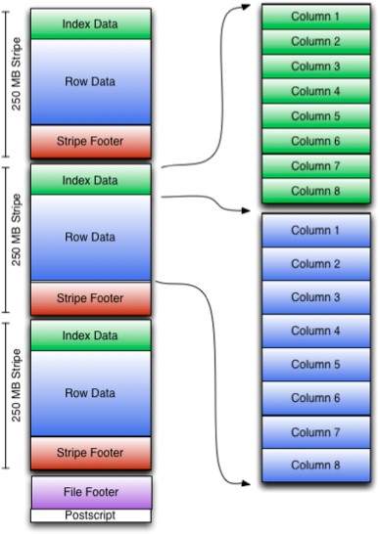
Structure: ORC
Row groups called Stripes
Index Data contain column min/max values and row positions within each column
Bit field / bloom filter as well (if included)
Used for selection of stripes / row groups, not for answering queries
Row Data contains the actual data
Stripe Footer contain directory of stream locations
Postscript contains compression parameters and size of the compressed footer
https://bit.ly/2A7AlS1

Slide 28
Inspecting: ORC
* Some formatting applied
$ orc-tools meta part-00000-34aef610-c8d4-46fb-84c9- b43887d2b37e-c000.snappy.orc
Processing data file part-00000-34aef610-c8d4-46fb-84c9- b43887d2b37e-c000.snappy.orc [length: 574]
Structure for part-00000-34aef610-c8d4-46fb-84c9-b43887d2b37e- c000.snappy.orc
File Version: 0.12 with ORC_135 Rows: 4
Compression: SNAPPY
Compression size: 262144
Type: struct<score:double,student_id:bigint,subject:string>
Stripe Statistics: Stripe 1:
Column 0: count: 4 hasNull: false
Column 1: count: 4 hasNull: false bytesOnDisk: 35 min: 73.11
max: 97.44 sum: 346.65
Column 2: count: 4 hasNull: false bytesOnDisk: 9 min: 13
max: 101 sum: 218
Column 3: count: 4 hasNull: false bytesOnDisk: 37 min: geography max: physics sum: 27
File Statistics:
Column 0: count: 4 hasNull: false
Column 1: count: 4 hasNull: false bytesOnDisk: 35 min: 73.11
max: 97.44 sum: 346.65
Column 2: count: 4 hasNull: false bytesOnDisk: 9 min: 13 min:
101 sum: 218
Column 3: count: 4 hasNull: false bytesOnDisk: 37 min:
geography max: physics sum: 27
Stripes:
Stripe: offset: 3 data: 81 rows: 4 tail: 75 index: 123
Stream: column 0 section ROW_INDEX start: 3 length 11
Stream: column 1 section ROW_INDEX start: 14 length 44
Stream: column 2 section ROW_INDEX start: 58 length 26
Stream: column 3 section ROW_INDEX start: 84 length 42
Stream: column 1 section DATA start: 126 length 35
Stream: column 2 section DATA start: 161 length 9
Stream: column 3 section DATA start: 170 length 30
Stream: column 3 section LENGTH start: 200 length 7 Encoding column 0: DIRECT
Encoding column 1: DIRECT Encoding column 2: DIRECT_V2 Encoding column 3: DIRECT_V2
File length: 574 bytes Padding length: 0 bytes Padding ratio: 0%

Slide 29
Config: ORC
* Default value is underlined
spark.sql.orc.impl
spark.sql.orc.filterPushdown
What: The name of ORC implementation
Options: {native, hive}
What: Enable filter pushdown for ORC files
Options: {true, false}
spark.sql.orc.compression.codec
spark.sql.orc.enableVectorizedReader
What: Compression codec used when writing ORC files
Options: {none, uncompressed, snappy, zlib, lzo}
What: Enables vectorized orc decoding
Options: {true, false}
spark.sql.orc.mergeSchema
What: (3.0+) ORC data source should merge schemas from all files (else, picked at random)
Options: {true, false}
spark.sql.orc.columnarReaderBatchSize
What: Number of rows to include in a ORC vectorized reader batch.
Options: Int
Default: 4096

Slide 30

About: Parquet
Originally built by Twitter and Cloudera Self-Describing
Hybrid-Based (rows grouped by row groups, then column partitioned)
Optimized for read-intensive applications
Binary Format – Schema stored inside of file Compressible
Splittable
Supported by natively in Spark Supports rich data structures

Slide 31
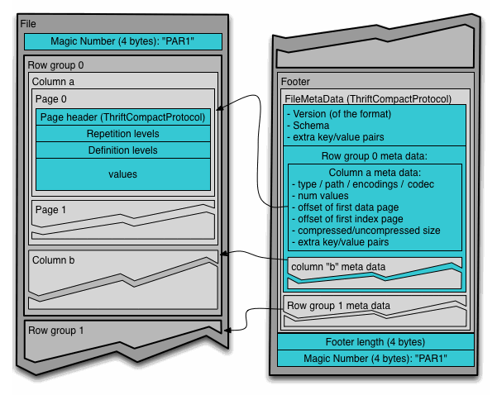
Structure: Parquet
Row Groups are a logical horizontal partitioning of the data into rows
Consists of a column chunk for each column in the dataset
Column chunk are chunks of the data for a column
Guaranteed to be contiguous in the file
Pages make up column chunks
A page is conceptually an indivisible unit (in terms of compression and encoding)
File metadata contains the locations of all the column metadata start locations

Slide 32
Inspecting: Parquet (1)
* Some formatting applied
$ parquet-tools meta part-00000-5adea6d5-53ae-49cc-8f70-a7365519b6bf-c000.snappy.parquet
file: creator:
file:part-00000-5adea6d5-53ae-49cc-8f70-a7365519b6bf-c000.snappy.parquet parquet-mr version 1.10.1 (build a89df8f9932b6ef6633d06069e50c9b7970bebd1)
extra: org.apache.spark.sql.parquet.row.metadata =
{"type":"struct","fields":[{"name":"score","type":"double","nullable":true,"metadata":{}},{"name":"student
_id","type":"long","nullable":true,"metadata":{}},{"name":"subject","type":"string","nullable":true,"metad ata":{}}]}
file schema: spark_schema
score: student_id: subject:
OPTIONAL DOUBLE R:0 D:1 OPTIONAL INT64 R:0 D:1 OPTIONAL BINARY O:UTF8 R:0 D:1
row group 1: RC:4 TS:288 OFFSET:4
score: DOUBLE SNAPPY DO:0 FPO:4 SZ:101/99/0.98 VC:4 ENC:PLAIN,BIT_PACKED,RLE ST:[min: 73.11, max:
97.44, num_nulls: 0]
student_id: INT64 SNAPPY DO:0 FPO:105 SZ:95/99/1.04 VC:4 ENC:PLAIN,BIT_PACKED,RLE ST:[min: 13, max: 101,
num_nulls: 0]
subject: BINARY SNAPPY DO:0 FPO:200 SZ:92/90/0.98 VC:4 ENC:PLAIN,BIT_PACKED,RLE ST:[min: geography,
max: physics, num_nulls: 0]

Slide 33
Inspecting: Parquet (2)
* Some formatting applied
DOUBLE score
---------------------------------------
*** row group 1 of 1, values 1 to 4 *** value 1: R:0 D:1 V:97.44
value 2: R:0 D:1 V:88.32
value 3: R:0 D:1 V:73.11 value 4: R:0 D:1 V:87.78
$ parquet-tools dump part-00000-5adea6d5-53ae-49cc-8f70-a7365519b6bf- c000.snappy.parquet
row group 0
-------------------------------------------------------------------------
score: student_id: subject:
DOUBLE SNAPPY DO:0 FPO:4 SZ:101/99/0.98 VC:4 ENC:RLE,BIT_ [more]... INT64 SNAPPY DO:0 FPO:105 SZ:95/99/1.04 VC:4 ENC:RLE,BIT_ [more]... BINARY SNAPPY DO:0 FPO:200 SZ:92/90/0.98 VC:4 ENC:RLE,BIT [more]...
score TV=4 RL=0 DL=1
---------------------------------------------------------------------
page 0: DLE:RLE RLE:BIT_PACKED VLE:PLAIN ST:[min: 73.11, max: 97. [more]...
INT64 student_id
*** row group 1 of 1, values 1 to 4 *** value 1: R:0 D:1 V:71
value 2: R:0 D:1 V:33 value 3: R:0 D:1 V:101 value 4: R:0 D:1 V:13
VC:4
student_id TV=4 RL=0 DL=1
---------------------------------------------------------------------
page 0: DLE:RLE RLE:BIT_PACKED VLE:PLAIN ST:[min: 13, max: 101, n [more]...
VC:4
BINARY subject
---------------------------------------
*** row group 1 of 1, values 1 to 4 *** value 1: R:0 D:1 V:math
value 2: R:0 D:1 V:history value 3: R:0 D:1 V:geography
value 4: R:0 D:1 V:physics
subject TV=4 RL=0 DL=1
---------------------------------------------------------------------
page 0: DLE:RLE RLE:BIT_PACKED VLE:PLAIN ST:[min: geography, max: [more]...
VC:4

Slide 34
Config: Parquet
* Default value is underlined
spark.sql.parquet.compression.codec
spark.sql.parquet.filterPushdown
What: Compression codec used when writing Parquet files
Options: {none, uncompressed, snappy, gzip, lzo, lz4, brotli, zstd}
What: Enables Parquet filter push-down optimization
Options: {true, false}
Similar:
spark.sql.parquet.filterPushdown.date
spark.sql.parquet.filterPushdown.timestamp
spark.sql.parquet.filterPushdown.decimal
spark.sql.parquet.filterPushdown.string.startsWith
spark.sql.parquet.pushdown.inFilterThreshold
spark.sql.parquet.recordLevelFilter.enabled
spark.sql.parquet.mergeSchema
What: Parquet data source merges schemas collected from all data file (else, picked at random)
Options: {true, false}
spark.sql.parquet.columnarReaderBatchSize
What: Number of rows to include in a parquet vectorized reader batch
Options: Int
Default: 4096
spark.sql.parquet.enableVectorizedReader
What: Enables vectorized parquet decoding
Options: {true, false}

Slide 35
Case Study: Veraset

Slide 36
Case Study: Veraset
Migration from CSV -> snappy compressed Parquet
Veraset processes and delivers 3+ TB data daily Historically processed and delivered data in CSV
Pipeline runtime ~5.5 hours
OLAP Workflow
Data used by read-intensive applications
Schema fixed (no schema evolution)
Strictly typed and fixed columns
Heavy analytics / aggregations performed on data
Processing-heavy workflow
Frequently read data – Snappy > GZip
Migration to snappy compressed parquet
Pipeline runtime ~2.12 hours

Slide 37
Disclaimer: Software can have bugs.

Slide 38
Case Study: Parquet Bug

Slide 39
Case Study: Parquet Partition Pruning Bug
Data formats are software and can have bugs - PARQUET-1246
Sort order not specified for -0.0/+0.0 and NaN, leading to incorrect partition pruning
If NaN or -0.0/+0.0 first row in group, entire row groups would be pruned out
Conclusion: Make sure you are frequently updating your data format version to get bug fixes and performance improvements

Slide 40

Looking Forward: Apache Arrow
In Memory Data Format
Complements (not competes with) on-disk formats and storage technologies to promote data exchange / interoperability
Interfaces between systems (ie. Python <> JVM)
Columnar layout in memory, optimized for data locality Zero-Copy reads + minimizes SerDe Overhead
Cache-efficient in OLAP workloads Organized for SIMD optimizations Flexible data model

Slide 41
Final Thoughts
Think critically about your workflows and needs – OLTP and OLAP, schema evolution, etc..
Migrating to formats optimized for your workflows can be easy performance wins
Perform load and scale testing of your format before moving to production
Don’t neglect the impact of compression codecs on your IO performance
Keep format libraries up-to-date

Slide 42

Thank you! vinoo.ganesh@gmail.com

Slide 43

Feedback
Your feedback is important to us.
Don’t forget to rate and review the sessions.

